Slide 1
Homeopathy & Meditation, a spiritual science
Presented by Dr Kavitha Kukunoor
CCH, RS Hom(NA), BHMS, C.HP

Slide 3
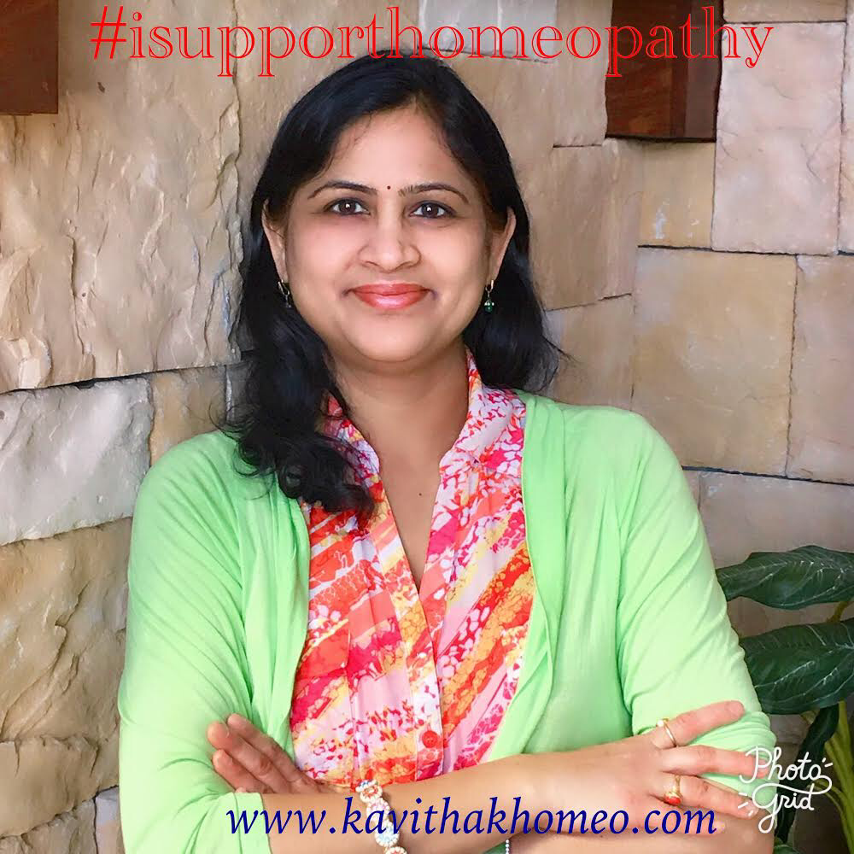
Introducing:
Kavitha Kukunoor
Bachelors in homeopathy -BHMS (India)
Nationally Board Certified Classical Homeopath CCH - USA
Registered member of NASH -
Rs Hom(NA) - USA
Certified HP Supervisor in Homeoprophylaxis
Served FHCi Board in 2019
Served HPWWC Board in 2019
Past HWC President & COO
Life time member of NCH
Associate Editor - Homeopathic Heritage
LMHI member – Liga Medicorum Homoeopathica Internationalis

Slide 4
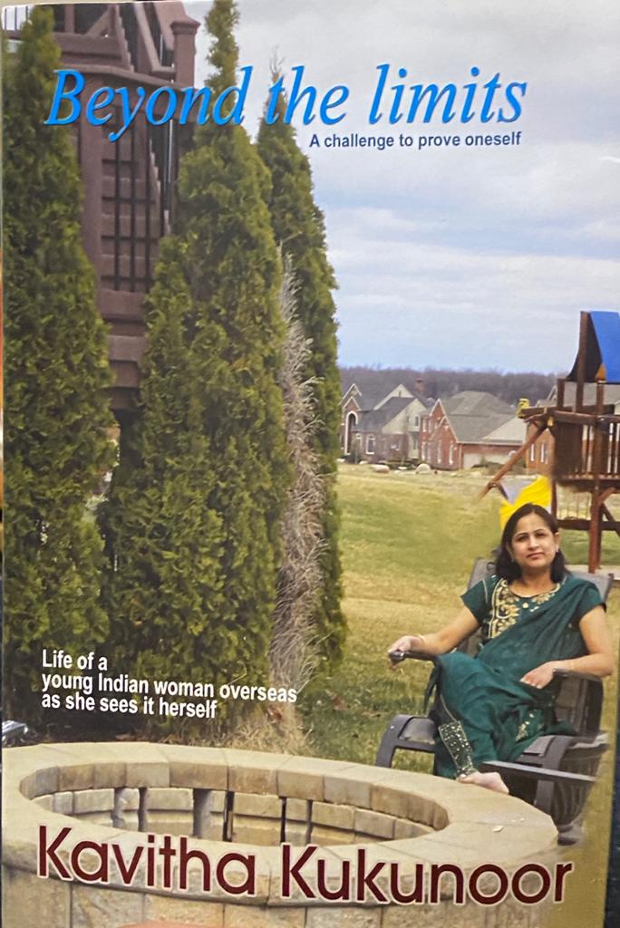
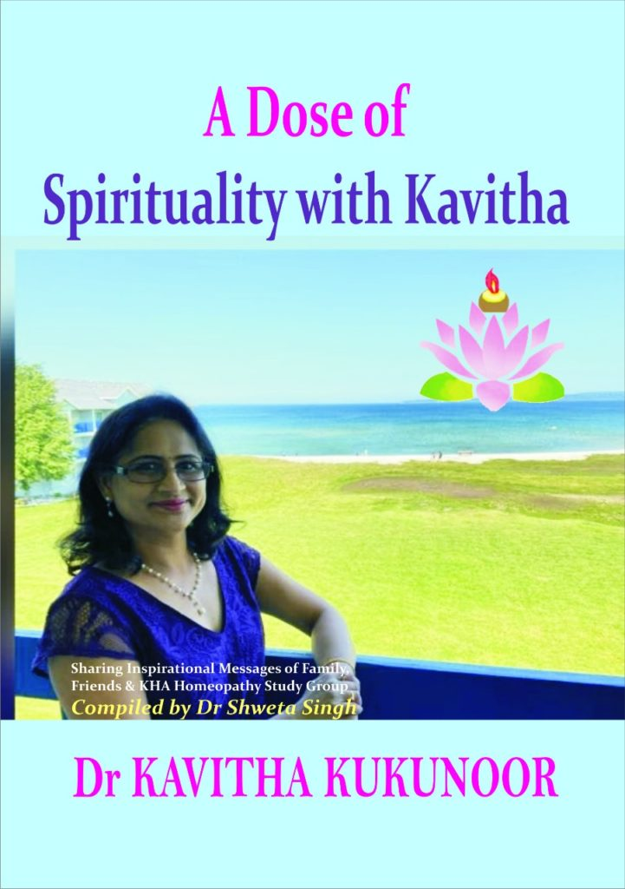
AWARDS &RECOGNITION
Martha Oelman Community Service Award 2021 from National Center for Homeopathy (NCH) at Joint American Homeopathic Conference (JAHC)
Best Entrepreneur of the Year in 2020 from JSPS Govt Homeopathic Medical College, Ramanthapur, India
Legendary Homeopath Award in 2022 from the health minister of Uttarakand, India at the first national homeopathic conference organized by Homeo Cure Research Institute & cure.
Recognized & honored by TANA (Telugu Association of North America) at Ladies Night out on Oct 2022, in Michigan for humanitarian services and it was a honor to get published at Island Lake Magazine.
DTA (Detroit Telugu Association) honored with the Community Service Award 2023 on Mother’s Day.
Women of the Year 2023 from prestigious NATA (North American Telugu Association), at International Women’s day, Michigan, USA
Member of Kavin friendly foundation, charitable, Non-Profit Organization that serves poor people in India
Author of 2 books “Beyond the limits – A Challenge to prove oneself” And “A Dose of Spirituality with Kavitha”

Slide 5
Welcome
We ourselves feel that what we are doing is just a drop in the ocean. But the ocean would be less because of that missing drop.
— Mother Teresa —
Disclaimer: Images used in the ppt are for educational purposes only.
Notes:
Every one here knew Meditation but today I am going to share my experiences how see Homeopathy & meditation as spiritual sciences. Shared knowledge & wisdom, which I gained over the years.

Slide 6
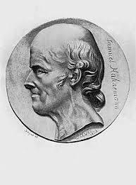
HOMEOPATHY
Homeopathy is a scientific & holistic method of healing. It is a dynamic system of medicine, addressing the root/basic cause of sickness.
Homeopathy, founded by medical doctor Dr. Samuel Hahnemann in the late 18th century, operates on the principle of “like cures like”, “Similia Similibus Curanter”, which is nature’s principle.

Slide 7
HOMEOPATHY
It is based on Hahnemann`s discovery that a natural substance is capable of creating symptoms in a healthy person during proving, the same substance is also capable of curing the similar symptoms that match in the disease condition.
Homeopathy treats the whole person rather than just the disease symptoms.

Slide 8
Meditation
“Meditation silences the incessant restless and useless waves of the mind, thereby preserving the soul’s energy leading to good health, great peace of mind and perfect wisdom in life”
Meditation is a Spiritual scientific process which develops neuro plasticity.

Slide 9
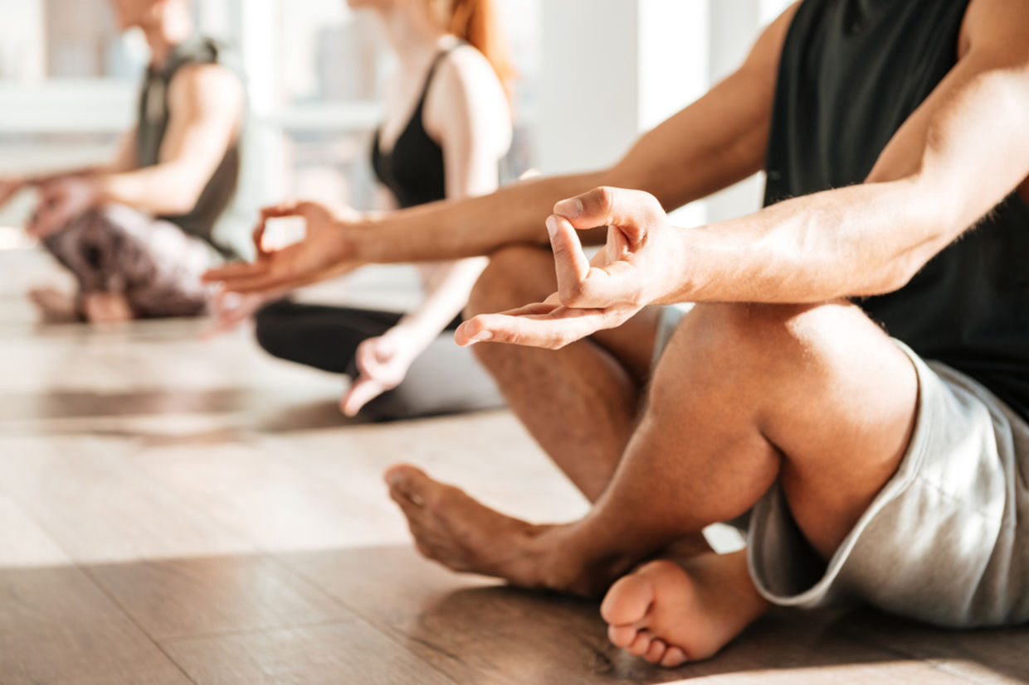
What Happens When We Meditate :
“When we are with the breath-energy, the mind becomes rather empty.
Then, there is a tremendous in-flow of cosmic energy into the physical body.
Gradually, the hitherto dormant third-eye begins to become activated & we experience cosmic consciousness

Slide 10
Meditation is practiced in all
religions and in every scriptures.
https://youtu.be/hjtEEqavPmg?si=38SL7NvhHsYw1NuE

Slide 11
Pyramid Meditation
Meditation done inside a pyramid, or underneath a pyramid, is called as Pyramid Meditation.
Meditation done inside a Pyramid is thrice more powerful
Many people experience feelings ranging from calmness to extreme euphoria during their meditation sessions inside the pyramids.
Pyramids provide most effective high-energy environments & help to reduce the level of stress and tension in the physical body

Slide 12
As Patriji says science behind pyramid meditation that We are all specks of energy, consciousness and knowledge,the whole nature, the whole creation, the full of infinite number of beings. Every event is always in a dynamic state.
Most people who have experimented with Pyramid Meditation, describe themselves as experiencing a total relaxation of their body, followed by the shutting out of unnecessary external stimuli and irrelevant thoughts and finally achieving an altered state of consciousness which allows them to concentrate on deeper inner levels.

Slide 13
SPIRITUAL SCIENCES
“Spiritual science sees health as a reflection of harmony between body, mind, and spirit.”
Homeopathy & Meditation both are spiritual sciences, making us live consciously to the fullest and blissful higher existence.
The science behind Homeopathy & breath mindfulness Meditation is Quantum Physics. Everything is energy, where your attention goes their the energy flows.

Slide 14
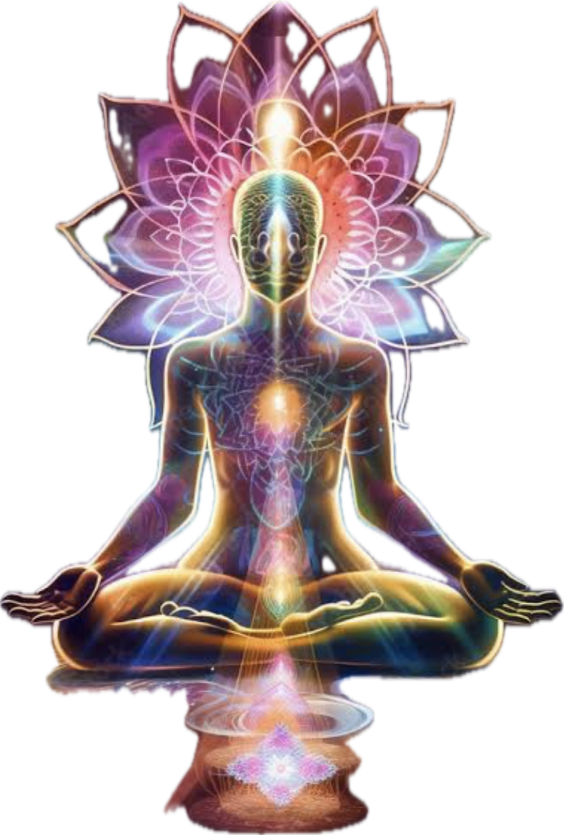
SPIRITUAL SCIENCES
• Both Homeopathy and Meditation
contribute to Holistic Healing Approach
Non Duality Aadi Sankara Charya says we are single large field
• The integration of both practices offers a
comprehensive approach to wellness.
• Emphasizes self-healing and personal
responsibility in maintaining health.

Slide 15
Both are Neuroscience and Dr Hahnemann said to be a Observer, Meditation also says to observe breath. Thought creates things & it becomes our reality. When we are in a meditation state we observe or focus on our breath to empty our thoughts. That gives Energy.
Homeopathy & meditation deals with Heart & Brain coherence, which is called science of heart & both acts on autonomic nervous system, sympathetic, parasympathetic, neurons of brain.

Slide 16
As per Quantum physics Human being is made up of Organs, Cells, Molecules & Atoms which has electrons, protons & neutrons which is 99.999% empty and filled with energy has only 0.1% matter
we are less matter and more energy,
At subatomic particle level everything is both wave and particle leading to many possibilities
Non Duality Aadi Sankara Charya single large field
We are souls and we are not body

Slide 17
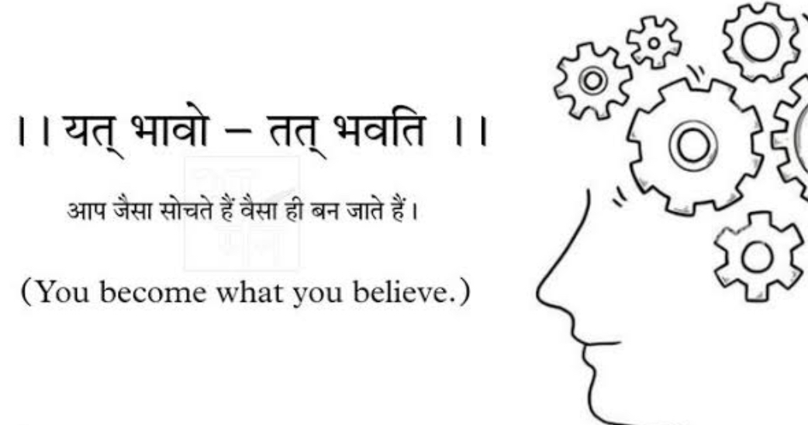
Non Duality Aadi Sankara Charya single large field
We are souls and we are not body
with unlimited possibilities and potential and
our Observation manifests the possibilities

Slide 18
Everything we call real is made of things that cannot be regarded as real
Neil Bohr, Quantum Physics
Quantum physics experiment -
Scientists released electrons which they couldn’t see where they are going when they started to see as conscious observer they could see the electron like God exists every where if you could feel his presence.

Slide 19
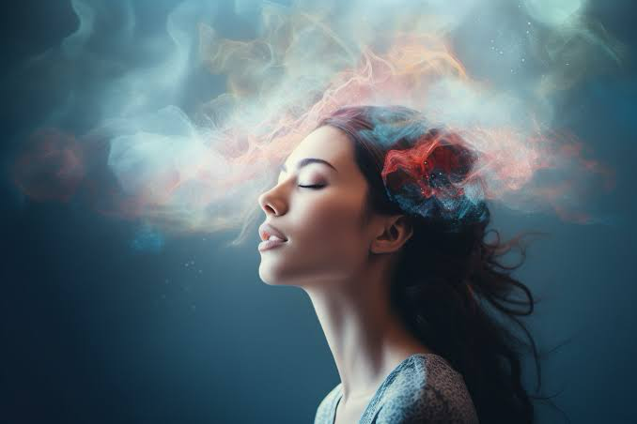
Synergy Between Homeopathy and Meditation
• Both focus on the holistic healing of the individual,
not just the symptoms.
• Aim to restore balance and harmony at a deep,"spiritual" level.
• Complementary Approaches
~Homeopathy can address the physical and
energetic imbalances.
~Meditation can enhance mental clarity and
emotional stability.

Slide 20
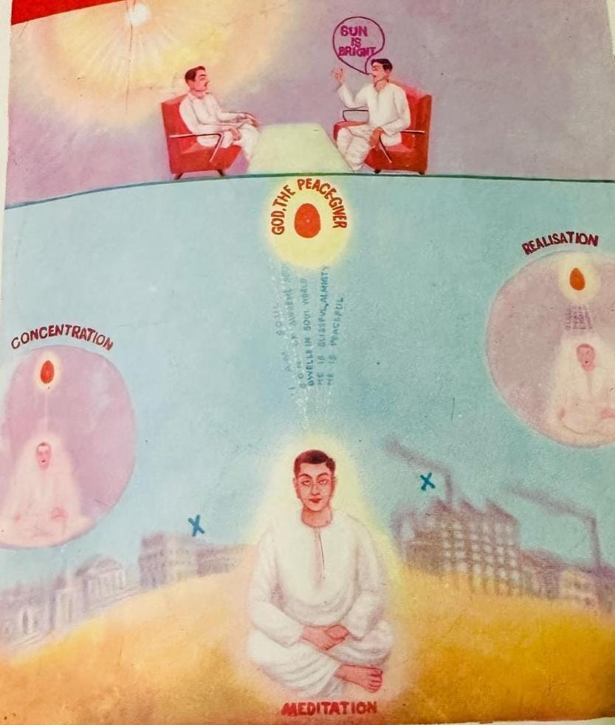
SPHERE OF ACTION
Just like Homeopathic remedies act at emotional, mental & spiritual level same way through meditation we can attain homeostasis, coherence, Appreciation, compassion & gratitude attend higher state of existence and understand purpose of our life

Slide 21
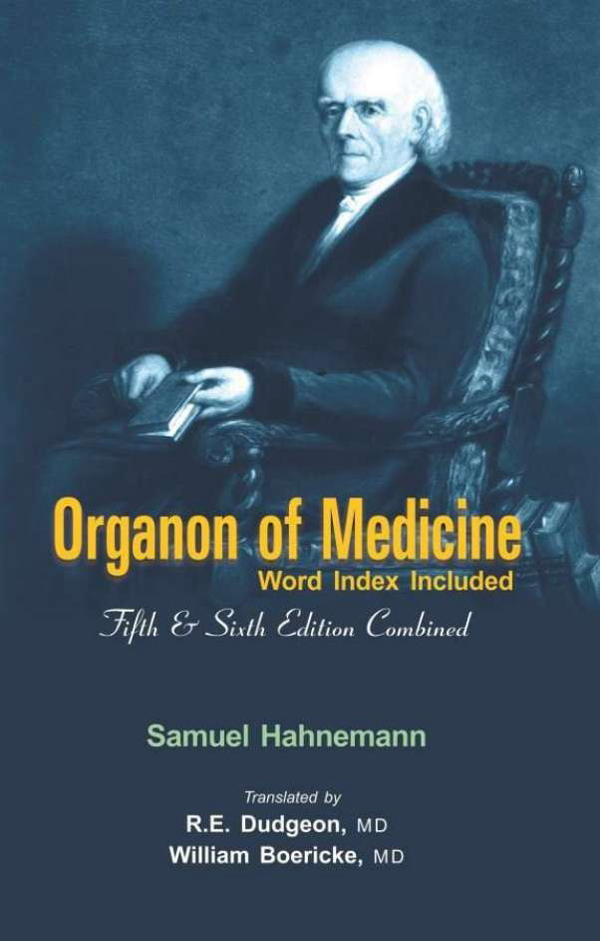
The principles & philosophy that guide homeopaths are documented in the book called Organon of Medicine.

Slide 22
§ 1 : Mission of Physician
The physician’s high and only mission is to restore the sick to health, to cure, as it is termed.
§ 2 : Highest Ideal of Cure
The highest ideal of cure is rapid, gentle and permanent restoration of the health, or removal and annihilation of the disease in its whole extent, in the shortest, most reliable and most harmless way, on easily comprehensible principles
§ 3 : True Practitioner of Healing Art If the physician clearly perceives what is to be cured in diseases …(knowledge of disease, indication) …curative in medicines….how to adapt, …what is curative in medicines to what he has discovered to be undoubtedly morbid in the patient, so that the recovery must ensue …..(choice of the remedy, the medicine indicated) …(proper dose), ..repeating the dose; …obstacles to recovery in each case and is aware how to remove them, so that the restoration may be permanent, ….he is a true practitioner of the healing art .

Slide 23
VITAL FORCE
Aphorism 9,
Hahnemann describes the vital force or life principle as a "spiritual" force that animates the material body.
Footnote: Hahnemann emphasizes that this vital force is of a "spiritual" nature and cannot be perceived by the senses, though its effects can be observed.
Aphorism 15
The disease in man is nothing else but an affection of this vital force, which is "spiritual" and immaterial.
Footnote: Discusses the "spiritual" nature of the vital force and its relationship with disease symptoms.

Slide 24
Aphorism 17,
The organism only lets its diseased state be known by morbid sensations and functions. This is an influence exerted upon the immaterial "spiritual" force (vital force).
Footnote: Explains how the diseased state affects the "spiritual" vital force, leading to symptoms.
Aphorism 19,
Content: Disease originates in the "spiritual" vital force that animates the human body.
Footnote: Reiterates that the origin of disease is in the "spiritual" force, not the material body.
Aphorism 73 : Acute diseases & Exciting Causes
Aphorism 74 : Chronic diseases

Slide 25
Aphorism 31,
The dynamic influence of morbific agents impacts the "spiritual" vital force.
Footnote: Mentions that the disease-causing agents disturb the "spiritual" vital force.
Aphorism 224,
The action of the homeopathic remedy is a dynamic, almost "spiritual" action on the vital force.
Footnote: Describes how remedies act on the "spiritual" level of the vital force.

Slide 26
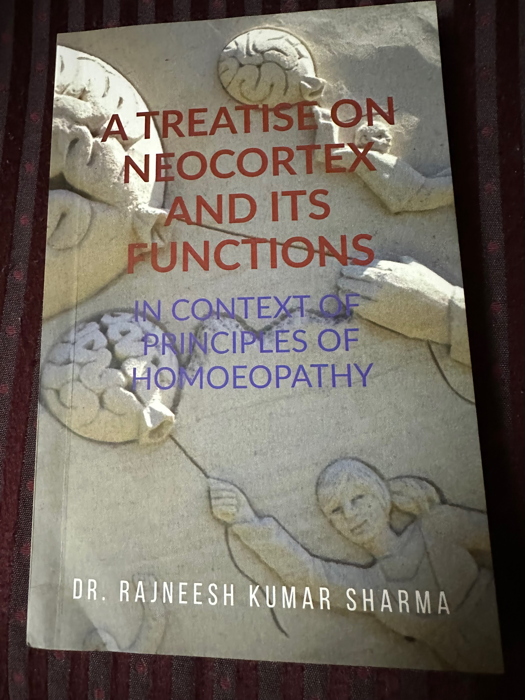

Slide 27
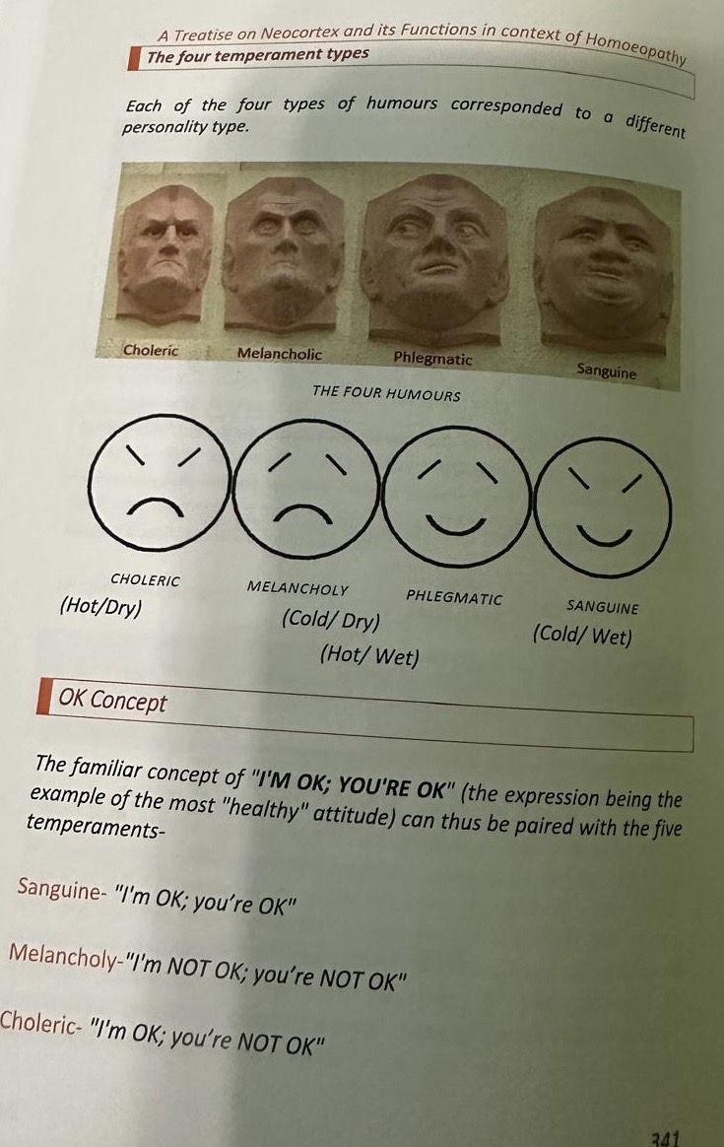
Temperaments

Slide 28
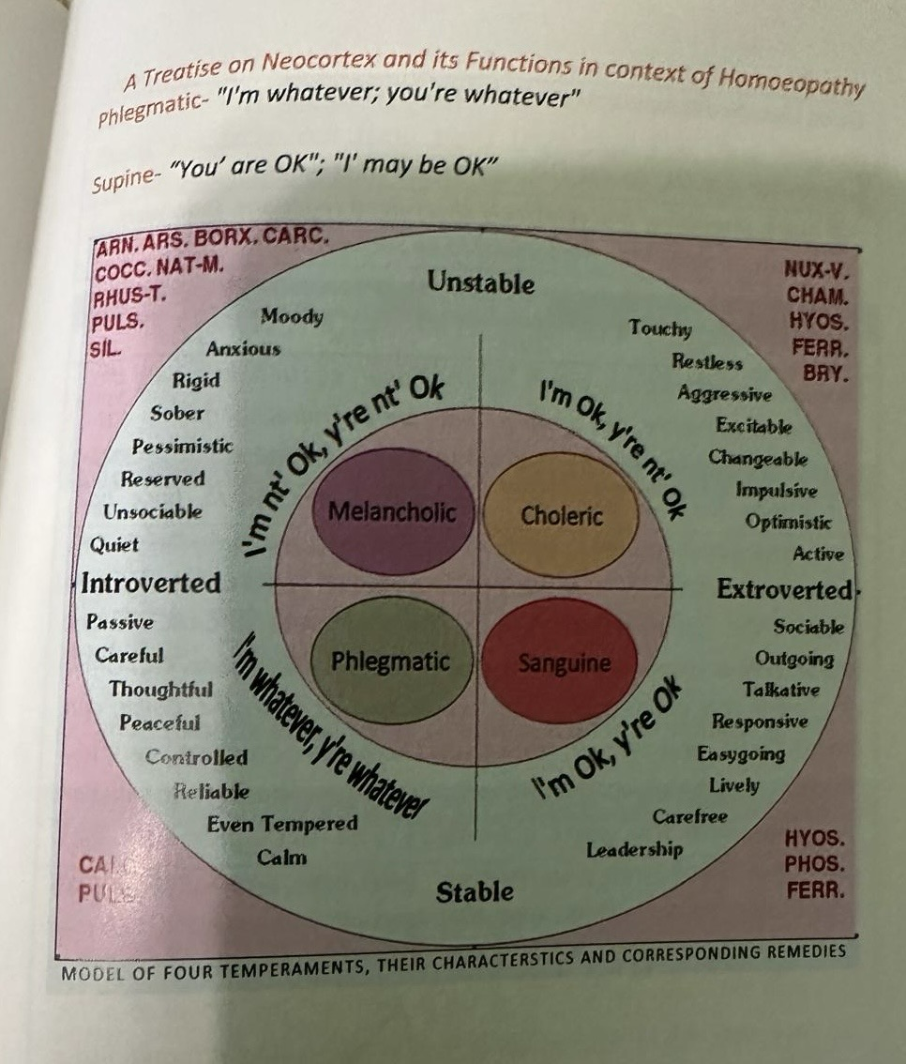
Temperaments & Remedies

Slide 29
Dr Rajneesh “A treatise on neocortex & its functions in context of principles of Homeopathy”.
Understanding Neocortex in terms of Homeopathic terminology for holistic healing of the individual:
Brain Stem lesions Bilateral /Unilateral cranial nerves involvement : PHOS, PLB, Nux V, ARN, APIS
Cerebellar lesions:Ataxia or Incoordination of movements: ALUM,CON
Change in handwriting: NUX, Ars, Ign, Lyc
Intentional tremors: Kali Br
Occipital Lobe lesions: Defects in vision (visual field cuts): Bell, Nat mur, Sulph, Gels
Parietal lobe lesions: Sensory inattention: ANAC, SEC etc
Homeopathic remedies exclusively working on Dopamine: ACON, ARS, AUR MERC etc
Mind - Unreal-everything seems Alum, Med
Mind Pleasure - Cann-I, carb-ac,lac del
Mind - Pain during - Cham, Vetat
Mind fear -duty-neglect his duty to: Aur

Slide 30
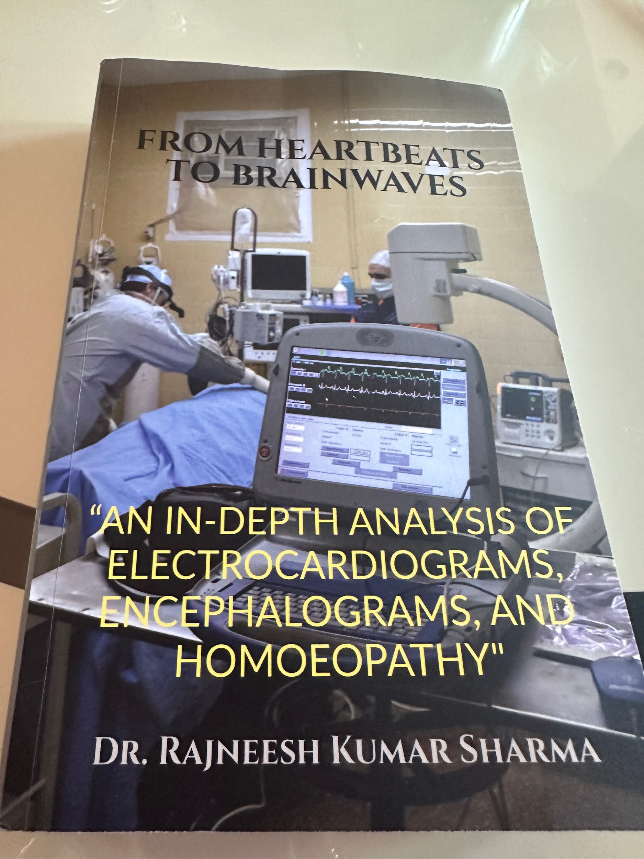
From Book “From Heartbeats to Brainwaves” by Dr Rajneesh Kumar Sharma
An In-Depth analysis of Electrocardiograms, Encephalograms and Homeopathy

Slide 31
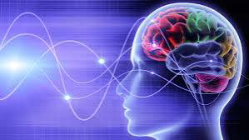
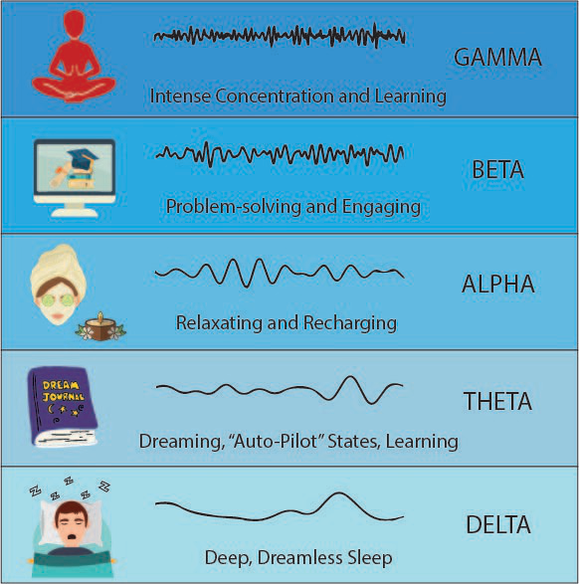
TYPES OF BRAIN WAVES

Slide 32
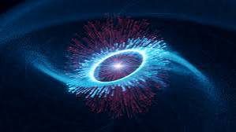
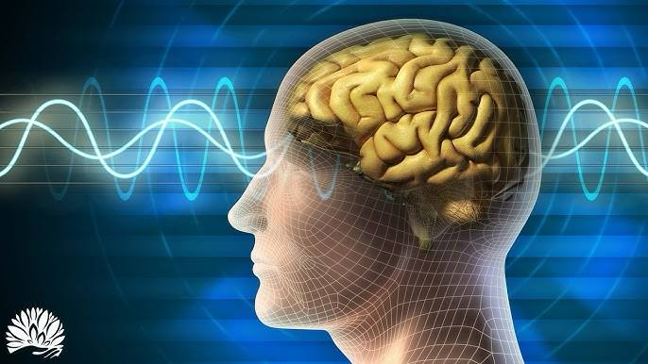
GAMMA WAVES
For Cognitive processes, higher order brain functions, for learning, memory consolidation & Information processing.Emotional & mental well being & performance optimization.
Increased : Anxiety, High arousal, stress
Decreased: ADHD, depression, learning disabilities
Optimal : Binding senses, cognition, information processing, learning perception, REM sleep.
Aggravation : Meditation
Homeopathic remedies for GAMMA WAVES Increased : Ars, Acon, Cocc, Cupr, Carc.
Homeopathic remedies for GAMMA WAVES Decreased : Anac, Phos, Sep, Agar, Carc.

Slide 33
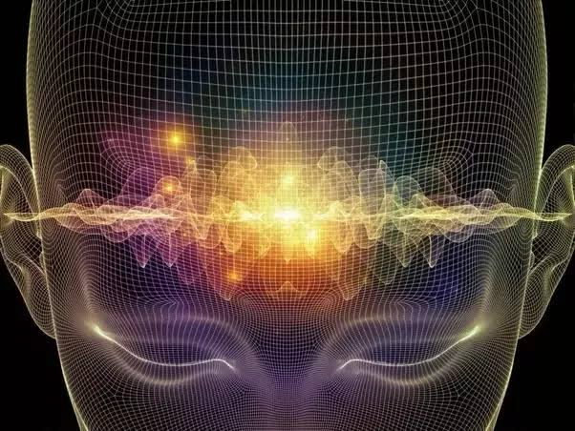
BETA WAVES
These are high frequency & low amplitude (16 Hz to 30 Hz) brain waves linked to physical world, processing sensory & motor actions. This neural activity includes conscious thought process & logical reasoning, with a stimulating effect on cognition.
Beta wave state -Stressful state
Uncontrollable thought is anxiety
Origin Bilaterally symmetrical Parietal and Frontal regions
Optimal level of beta waves helps in efficient concentration & facilitates the completion of task oriented activities.
Increased: Adrenaline, anxiety, high arousal, Inability to relax, stress
Decreased: ADHD, daydreaming, depression, poor cognition
Optimal: Conscious focus, memory, problem solving
Aggravation: Coffee, energy drinks, various stimulants
Homeopathic remedies for BETA WAVES Increased : Ars, Acon, Cocc, Cupr, Carc.
Homeopathic remedies for BETA WAVES Decreased : Lach, Nat m, Sep, Acon, Merc

Slide 34
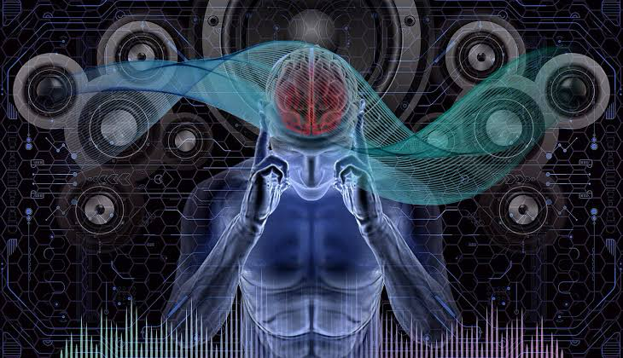
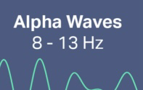
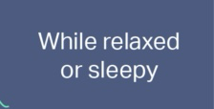
ALPHA WAVES
These moderate waves (9 Hz to 15 Hz) form crucial link between conscious recognition and the subconscious mind occupying the frequency spectrum between beta and theta waves. They are related to visualization, creative ideation and imaginative states.
Origin: Occipital region, bilateral, central during rest.
During meditation we see optimal Alpha waves with profound relaxation, tranquility and calmness, it tunes with nature.
Increased: Daydreaming, inability to focus, too relaxed
Decreased: Anxiety, high stress, insomnia, OCD
Optimal: Relaxation
Aggravation: Alcohol, marijuana, relaxants, some antidepressants
Homeopathic remedies for ALPHA WAVES Increased: Op, Phos, Sep, Lach, Nat mur.
Homeopathic remedies for ALPHA WAVES decreased: Ars, Cupr, Carc, Hyos, Acon.

Slide 35
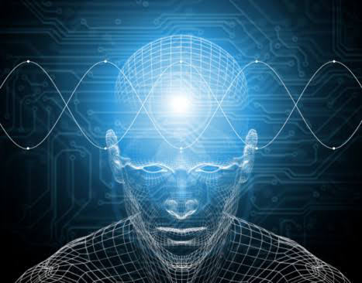
THETA WAVES
These low frequency & high amplitude waves evoke deep seated emotions, with profound insight and the innate intelligence of the body.
Origin: Parietal and temporal
Increased: ADHD, depression, hyperactivity, impulsivity, inattentiveness
Decreased: Anxiety, poor emotional awareness, stress
Optimal: Creativity, emotional connection, intuition, relaxation
Aggravation: Depressants
Homeopathic remedies for THETA WAVES Increased: Sep, Caust, Lach, Lyc, Plat
Homeopathic remedies for THETA WAVES decreased: Ars, Acon, Cocc, Cupr, Dulc.

Slide 36
DELTA WAVES
These slowest frequency (1 Hz to 4 Hz) predominantly observed in Infants & young children during deep sleep stages.
These waves are linked with profound levels of relaxation, rejuvenation during sleep and restoration, with neurological functioning and cognitive health.
Origin: Frontal in adults and Occipital in children
Increased: Brain Injuries, learning problems, inability to think, severe ADHD
Decreased: Inability to rejuvenate body, inability to revitalize the brain, poor sleep
Optimal: Immune system, natural healing, restorative/deep sleep
Aggravation: Depressants, sleep
Homeopathic remedies for DELTA WAVES Increased: Anac, Calc, Ph ac, Nat mur, Con.
Homeopathic remedies for DELTA WAVES Decreased: Graph, Apis, Sulph, Ars, Calc.

Slide 37
RESEARCH SHOWS…..
Amygdala which is emotional centre for fear : is shrinking for long term meditators, also empathy & feel good hormones (dopamine) are produced making us happy or to have a sound mind.
When we are Mindful & experience the moment we go into flow state, forget time & space & become non judgmental, accept the things as it is and we are satisfied & blissful.

Slide 38
TRAUMATIC STRESS
Homeopathic remedies are prepared from Natural sources and they address several mental health issues, Traumatic stress, depression, Suicidal & more to name few remedies like Ignitia, Natrum Mur, Naja, Aurum Metallicum, Cygnus Cygnus etc.
& through Meditation changes are happening in Quantum field energy and it calms our mind and body heals by mastering our mind through Emotional intelligence.

Slide 39
Homeopathy considers diseases as psychosomatic & heals from inside to out and through meditation many physical & emotional states are healed when our thoughts are made empty and energy is channeled right direction to heal the body as seen in Book “You are the Placebo by Dr Joe Dispenza” shows several Placebo research cases that got healed.

Slide 40
Practical Applications:
• Incorporating Meditation in Homoeopathic Practice
• Encouraging patients to practice meditation alongside their homoeopathic treatment.
• Offering guided meditation sessions as part of treatment plans.

Slide 41
Benefits for Practitioners
• Practitioners of Homoeopathy may also benefit from meditation to enhance intuition and empathy.
• Meditation can support a practitioner’s own spiritual growth, improving patient care.

Slide 42
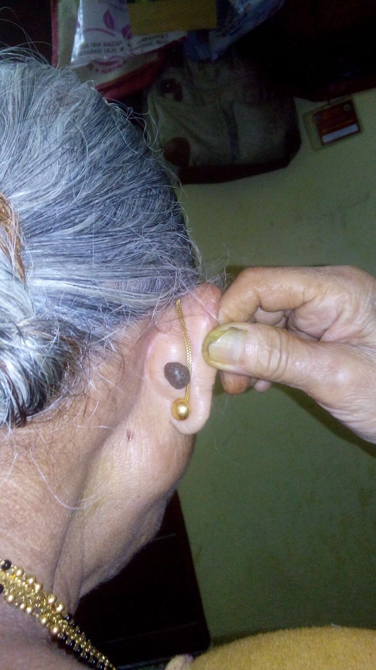
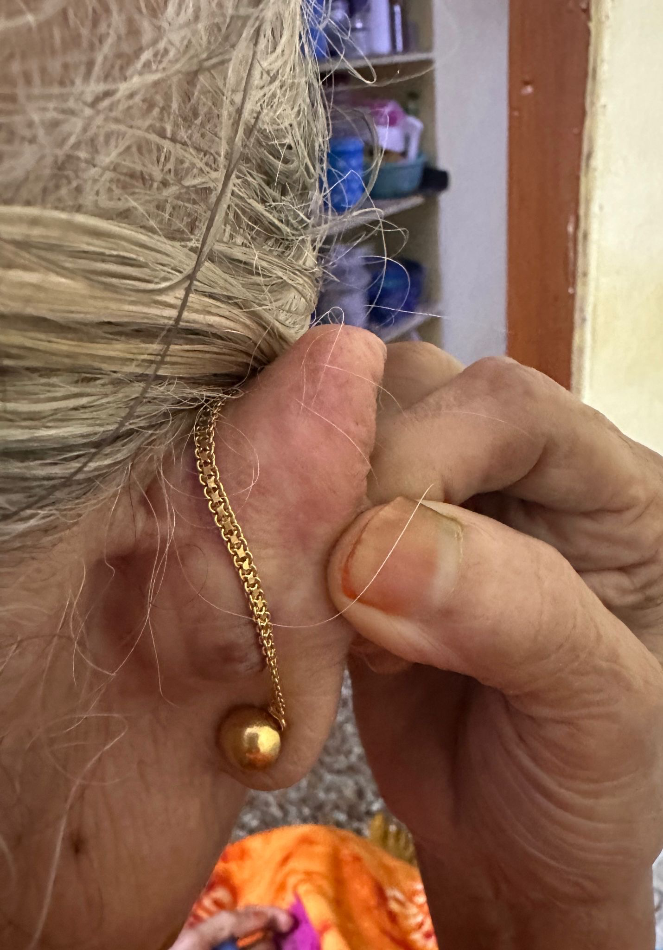
Case Discussion
Long standing single large flat wart behind Rt ear, painless wart, with itching. Wart was there for 25yrs. Got cured with Homeopathy & meditation with constitutional remedies.
Before
After

Slide 43
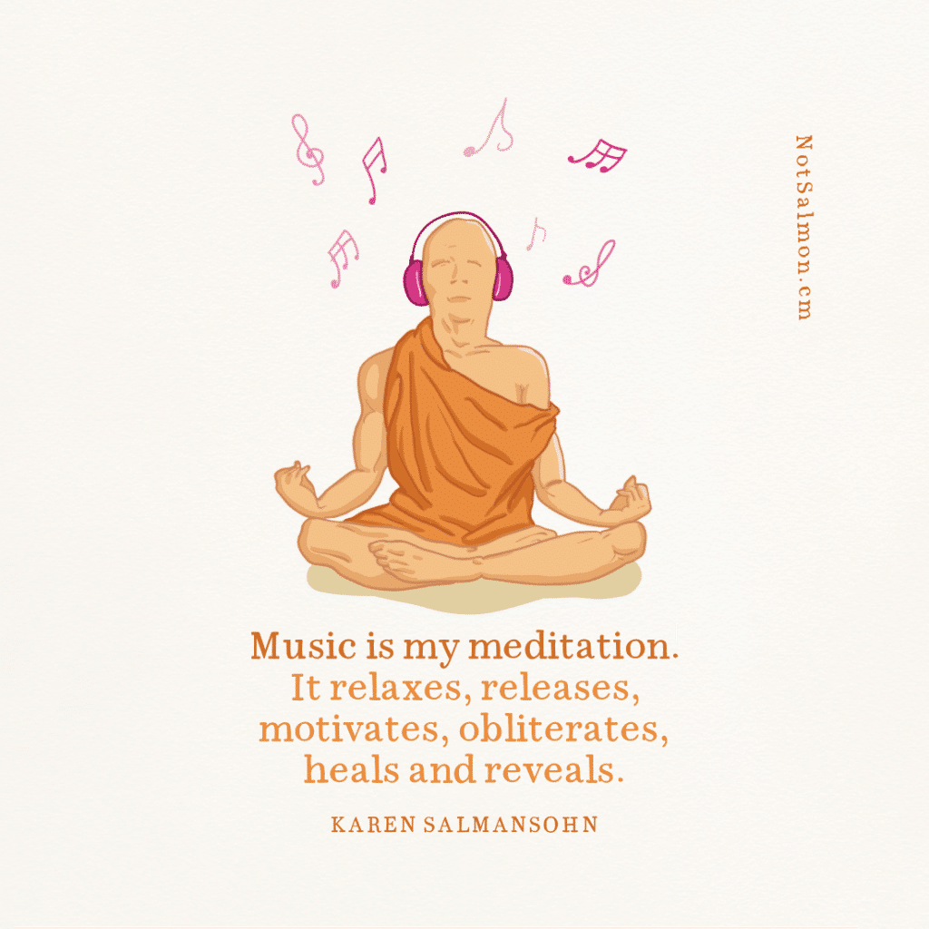
MUSIC
Can be our
Meditation

Slide 44
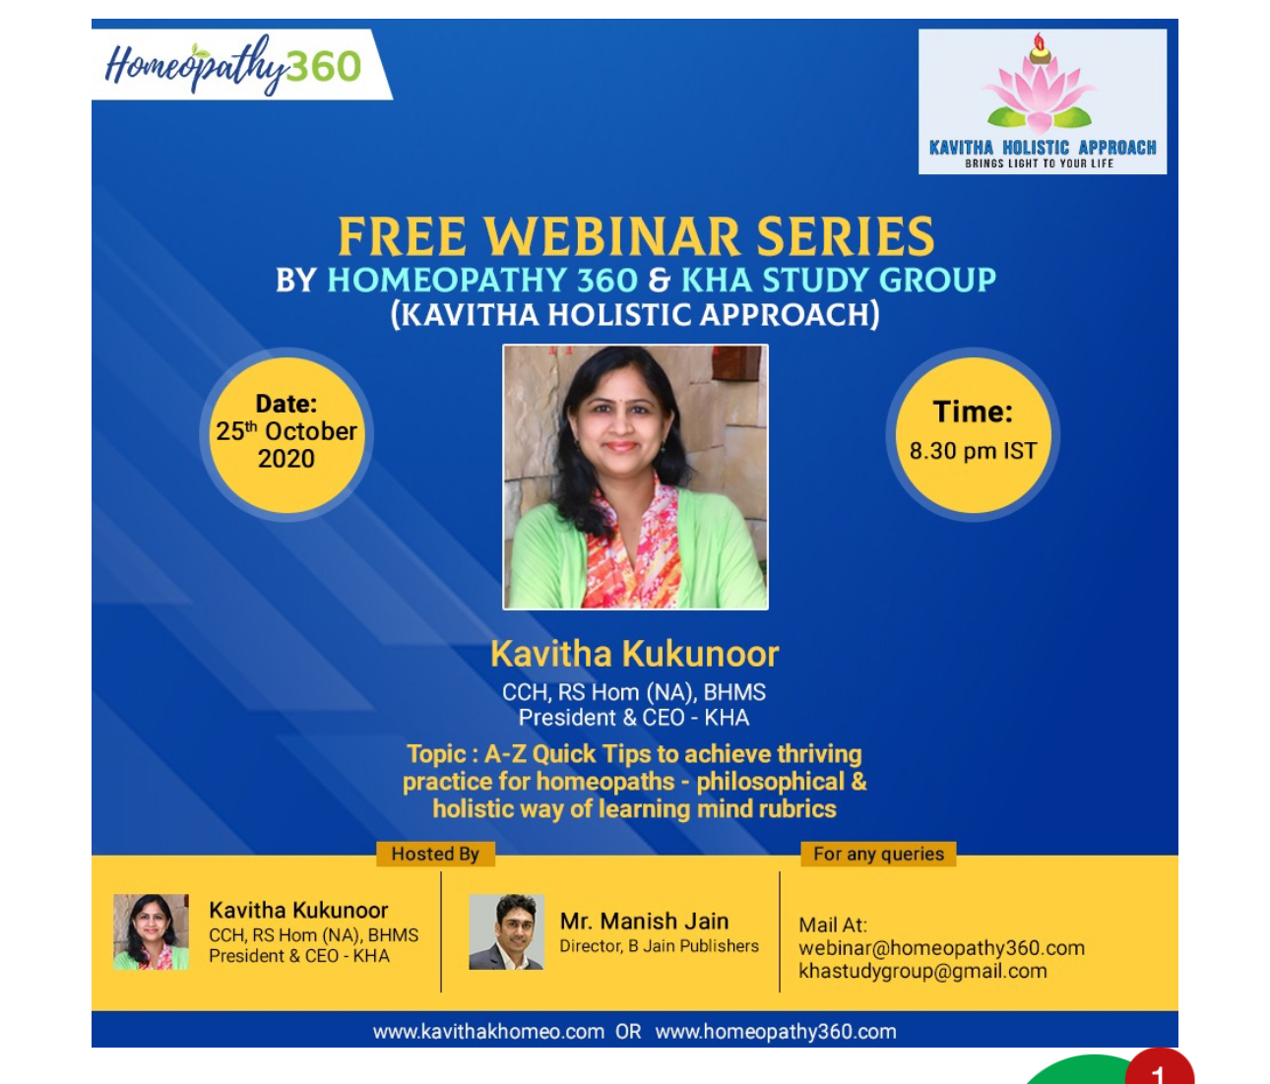
Philosophical & Holistic way of learning rubrics
https://kavithakhomeo.com/free-webinar-series-by-homeopathy-360-kha-study-group/

Slide 45
Acknowledgment
Pyramid meditation by Pitamaha Brahmashri Patriji:
www.pssmovement.org
Credit given to Easy Quantum Mechanics :
https://youtu.be/7u_UQG1La1o?si=F8TEf0f7PVztiI_v

Slide 46
Acknowledgment
• Hahnemann, S. (1810). Organon of Medicine.
• Key concepts on the "spiritual" vital force and the dynamic action of homoeopathic remedies.
• Research Articles on Meditation and Health
Goyal, M., Singh, S., Sibinga, E. M. S., et al. (2014). Meditation Programs for Psychological Stress and Well-being: A Systematic Review and Meta-analysis. JAMA Internal Medicine, 174(3), 357-368.
• Information on the benefits of meditation on psychological stress and overall well-being.

Slide 47
Acknowledgment
• Books on Meditation
Kabat-Zinn, J. (1994). Wherever You Go, There You Are: Mindfulness Meditation in Everyday Life.
• Concepts on mindfulness meditation and its application in everyday life.
Holistic and Integrative Medicine
• Koithan, M. (2009). Introducing Complementary and Alternative Therapies. Journal of Nurse Practitioners, 5(1), 18-20.
• Information on the integration of complementary therapies like Homoeopathy and Meditation in healthcare.
• https://www.pssmovement.org/meditation/

Slide 48
Conclusion
The Power of Combined Practices
Homoeopathy and Meditation together provide a profound approach to healing.
Address the body, mind, and spirit, leading to lasting wellness.
Future Directions: Encourage more research and practice integration.
Promote awareness of the spiritual dimensions of health.
Final Thoughts:
Embrace these practices for a healthier, more balanced life

Slide 49
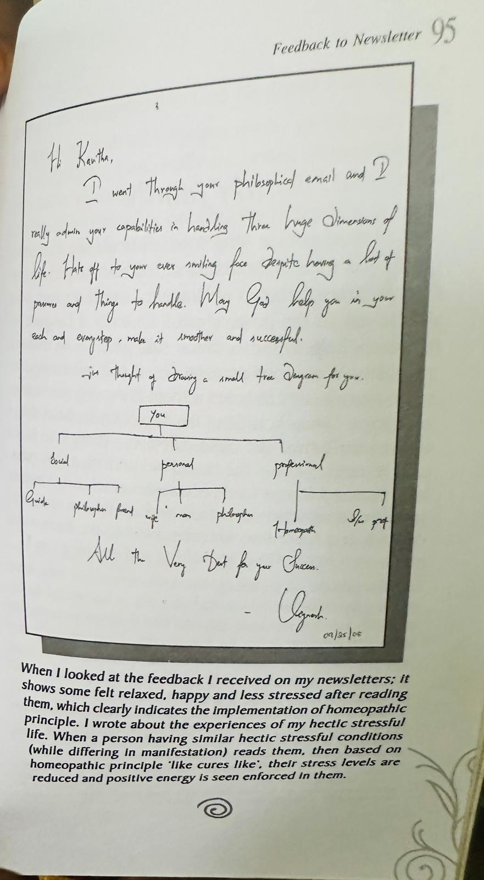
Reference:
Beyond the limits- A challenge to prove oneself

Slide 50
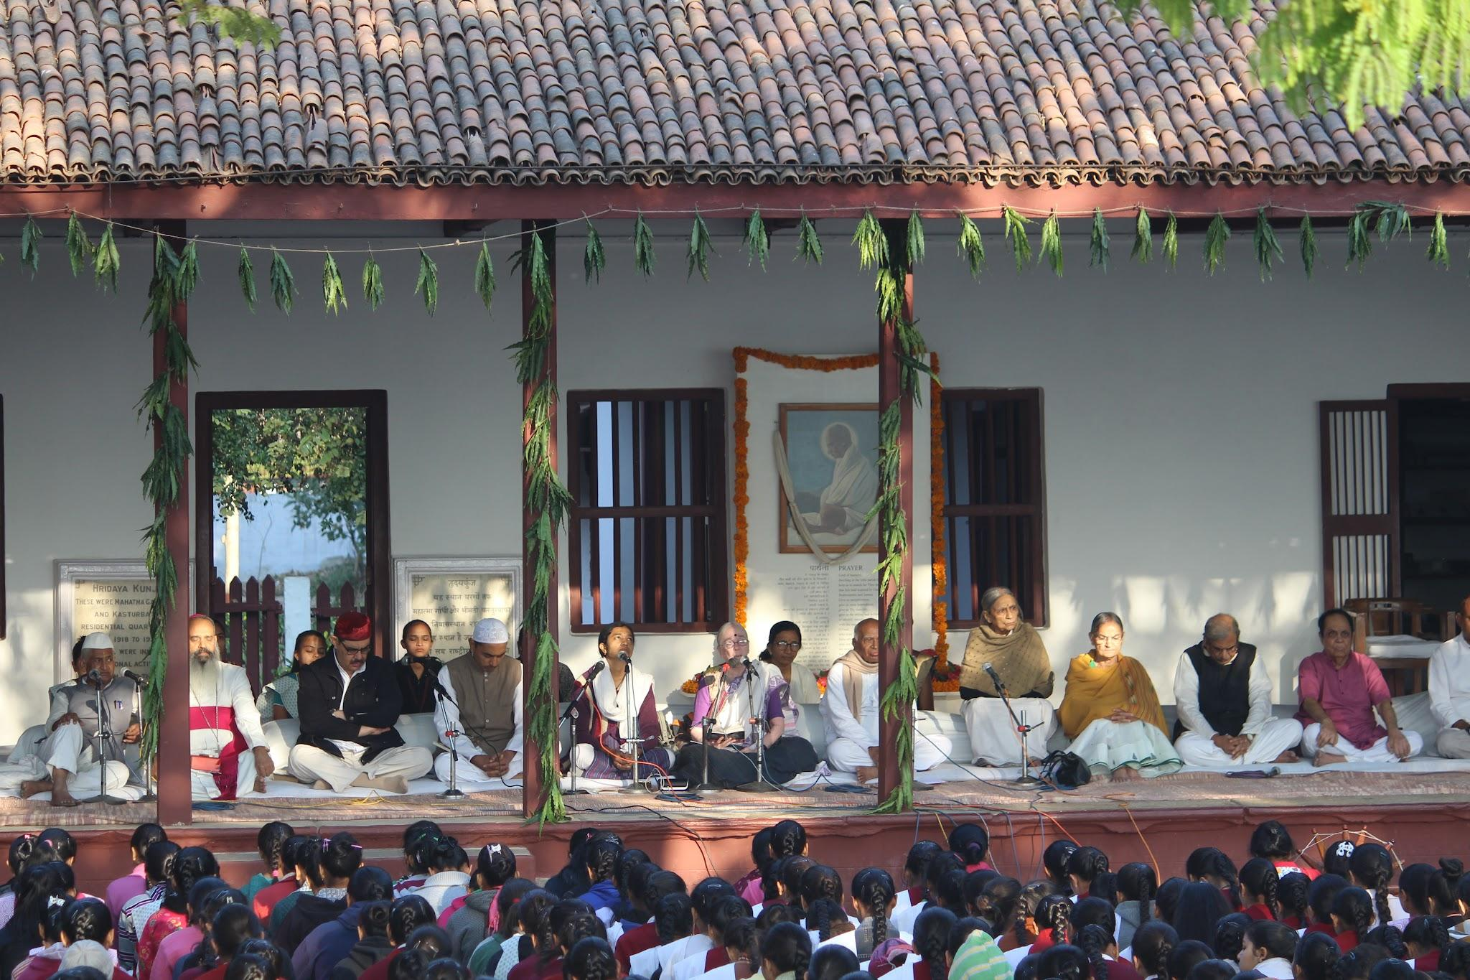
STUDY GROUP
Comfort
Peace
Serenity
Happiness
Harmony
Respect
Appreciation
Enthusiasm
Inspiration
Togetherness

Slide 51
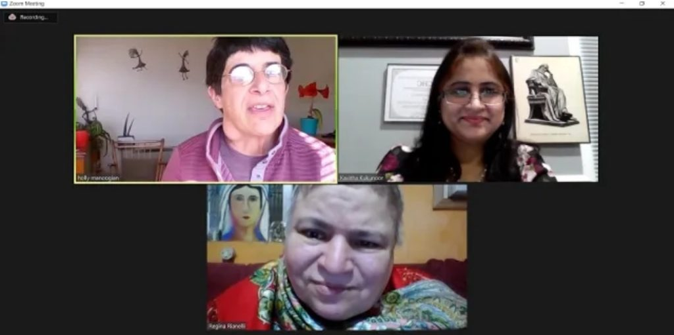
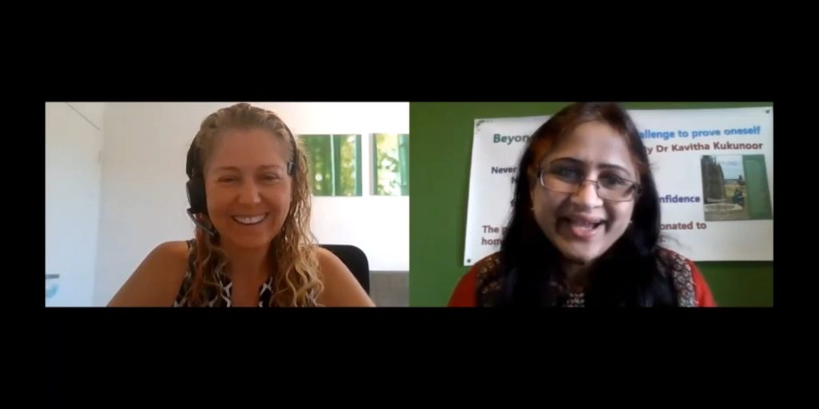
Inspirational Talks

Slide 52
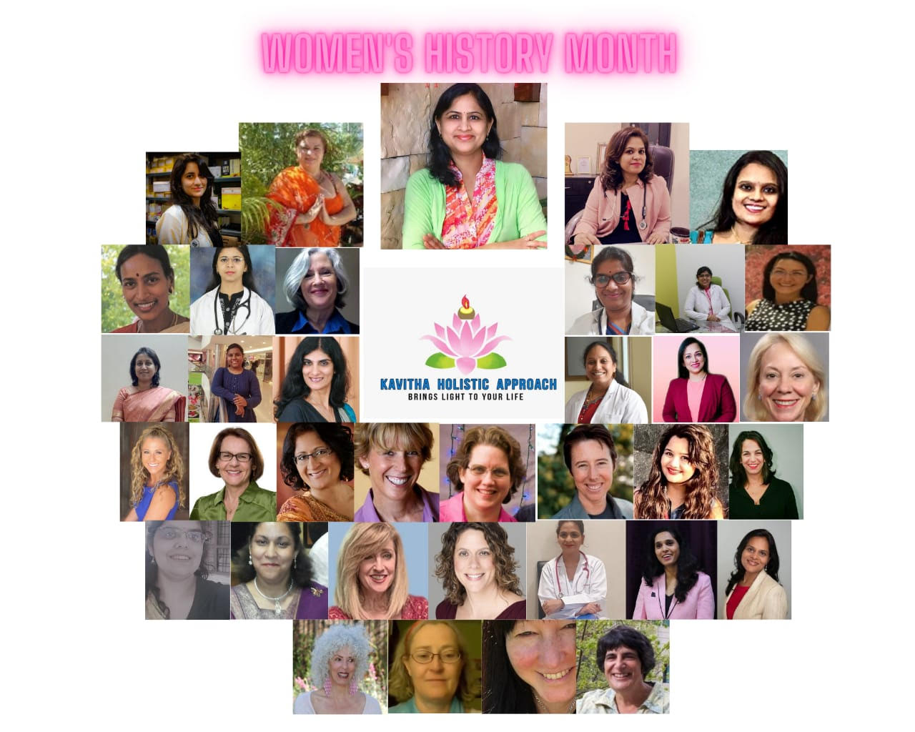

Slide 53
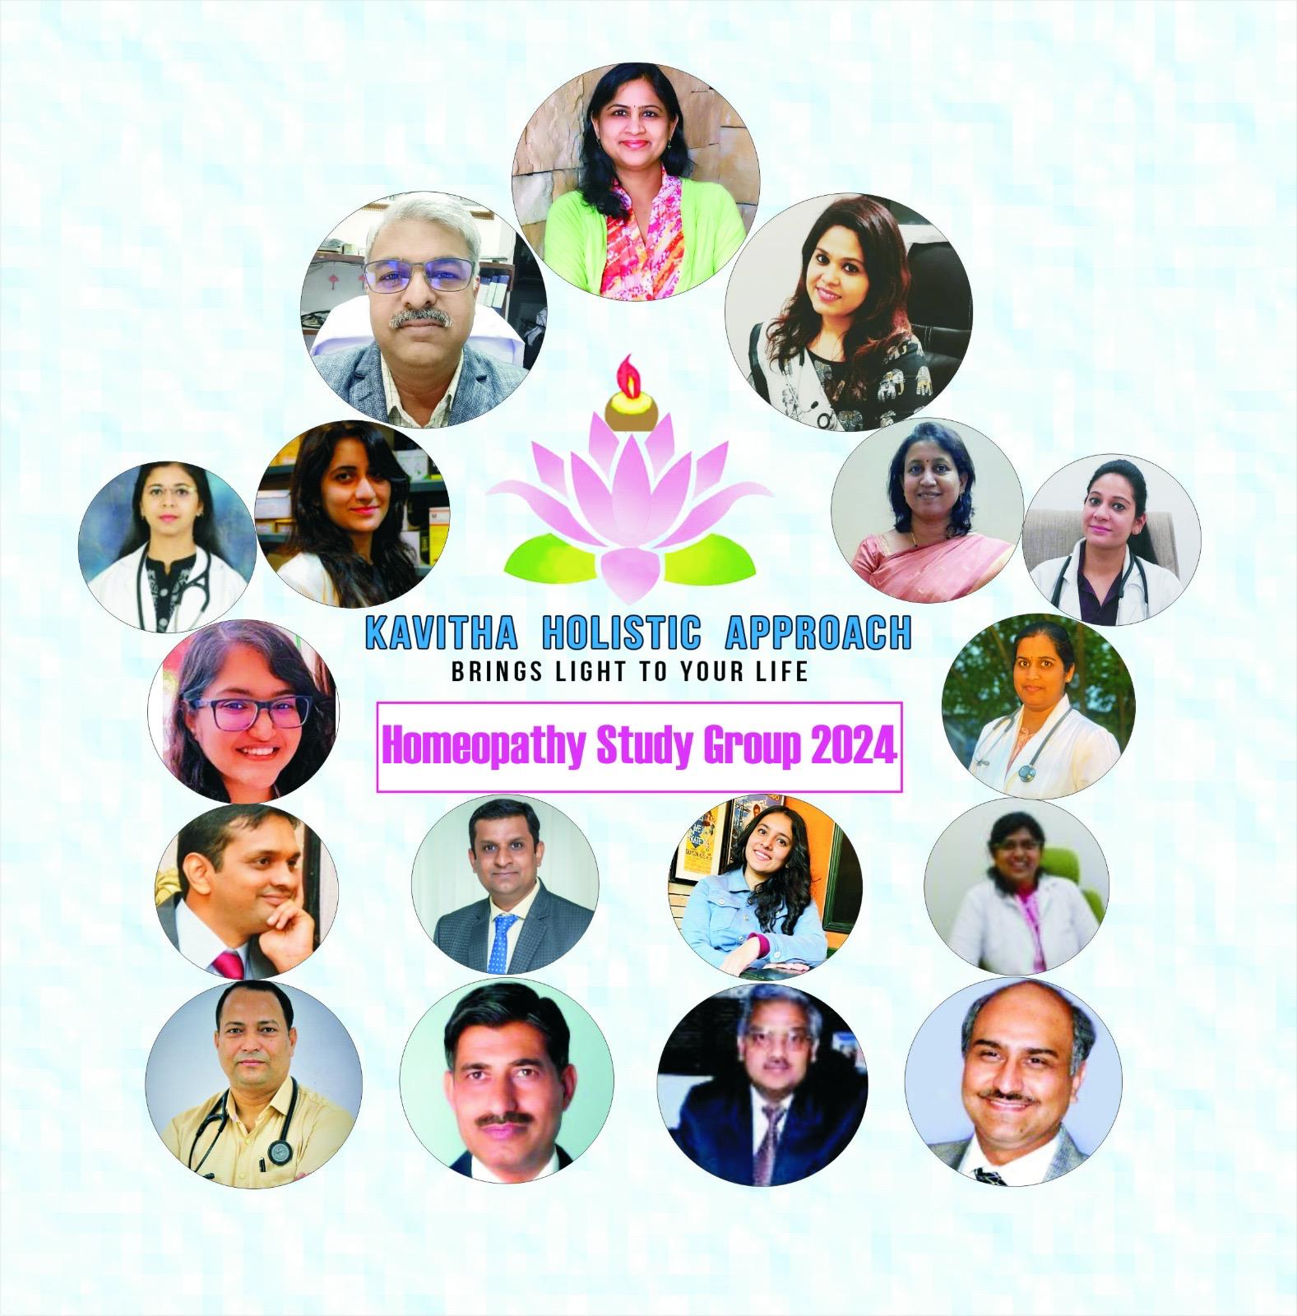

Slide 54
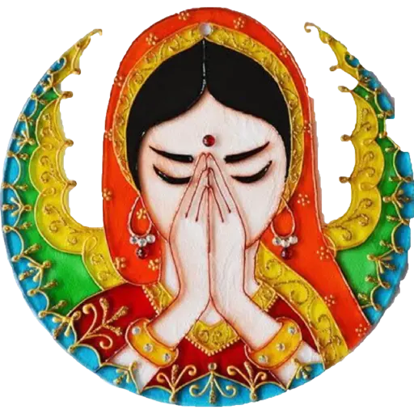
THANK YOU
For all inquiries please email at
khastudygroup@gmail.com
kavithakhomeo@gmail.com
To watch webinar recordings check
Youtube@Kavitha Kukunoor
www.kavithakhomeo.com
Template: Slidesgo; Images courtesy: Google

